Slide 1

Supply Chain Management
Group 5
Tejan Londhe
ShravanI Tamanna
Shobha R

Slide 2
Summary
4_5_4_CALENDAR
D_CUSTOMER
D_GEOJSON_US_COUNTIES
D_PRODUCT
D_STORE
F_INVENTORY_ADJUSTED
F_POINT_OF_SALE
F_SALES
PLUGS_ELECTRONICS_HANDS_ON_LAB_DATA

Slide 3
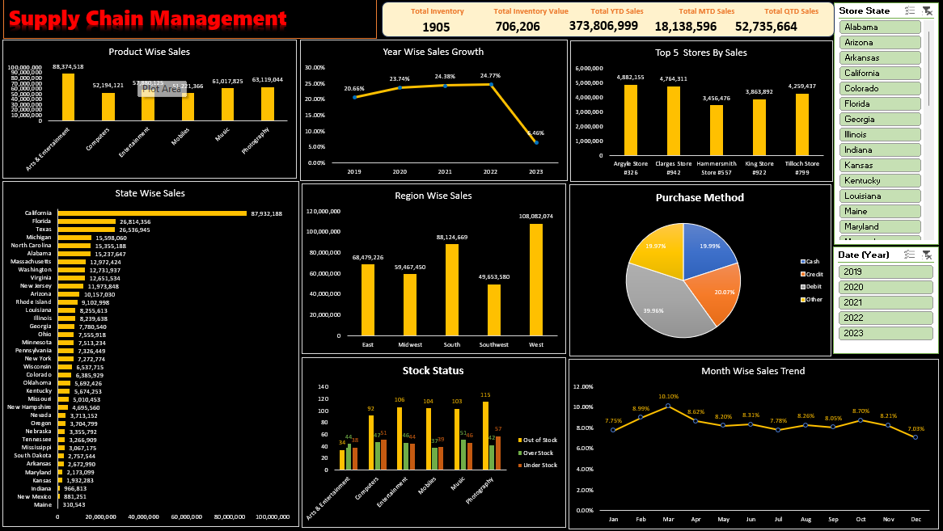
Excel Dashboard

Slide 4
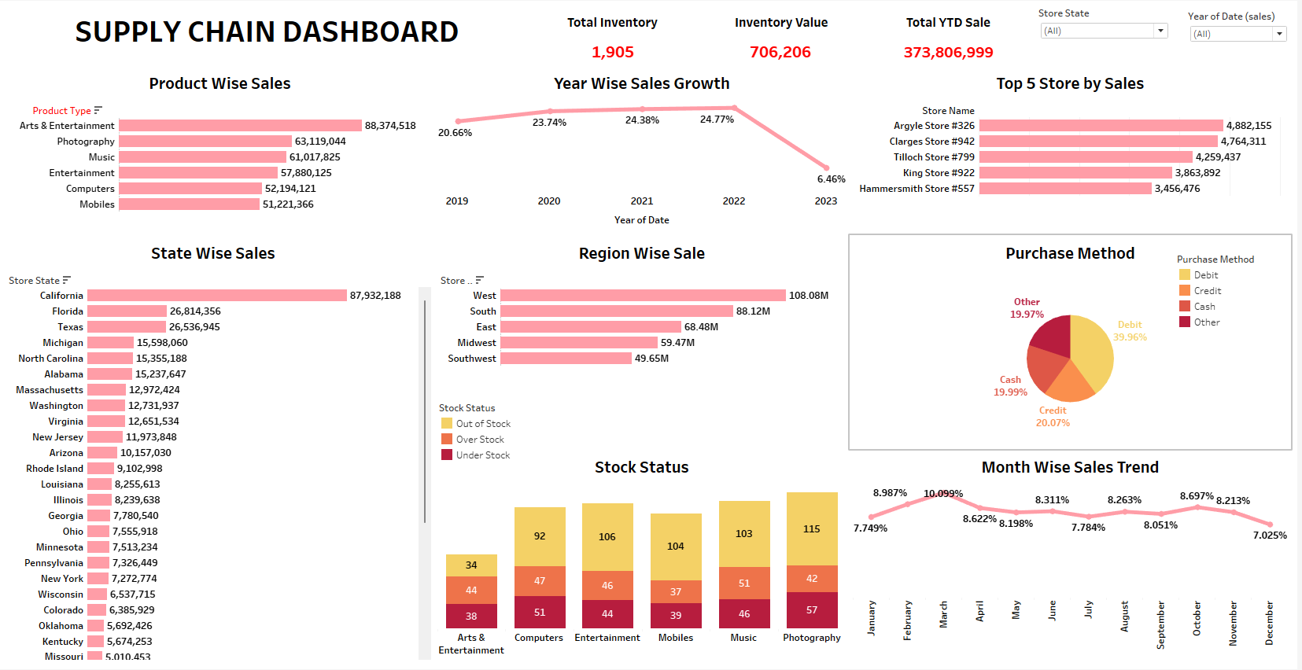
Tableau Dashboard

Slide 5
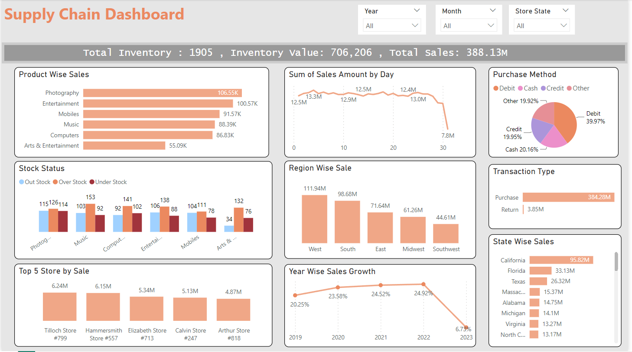
Power BI

Slide 6
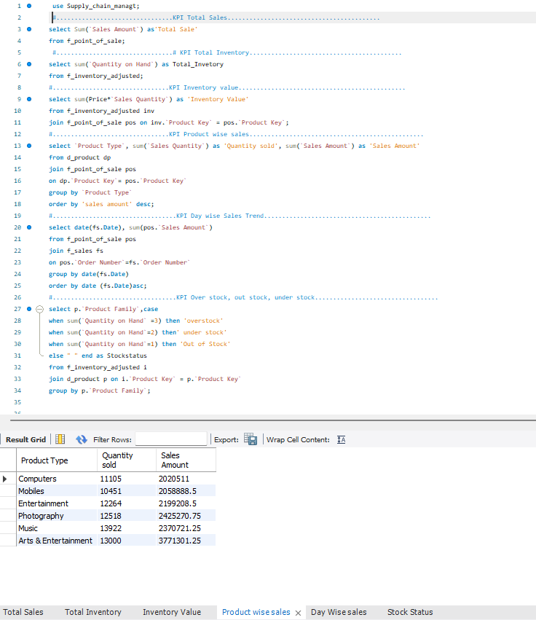
MySQL Queries

Slide 7
KPI’s
Total Sales(MTD,QTD,YTD)
Product Wise Sales
Sales Growth
Daily Sales Trend
State Wise Sales
Top 5 Store Wise Sales
Region Wise Sales
Total Inventory
Inventory Value
Over stock, Out Stock , Under stock

Slide 8

Thank You

